Slide 1
The Art of Good Proposal Writing
Feb 2018
Anonymous

Slide 2
Why?
The art of "grantsmanship" will not turn mediocre science into a fundable grant proposal but poor "grantsmanship" will, and often does, turn very good science into an unfundable grant proposal.
Good writing will not save bad ideas, but bad writing can kill good ones.
The Art of Grantsmanship, Jacob Kraicer

Slide 3
Me
I wrote my first proposal on rare disease in 2002 from a background in forensic science. I got it. I used the same process to raise the portfolio and position of my old institute in the EC arena
When I started:
25 projects, 3 coordinated (written by an external consultant), average budget €125K
By the time I left:
80+ live projects, 1 in 3 coordinated (written in house according to my guidelines), average budget €300K
Here at Pirbright:
3 projects applied for 2016, 1 of which was funded. 1 applied for last year. It was funded.

Slide 4

The bottom line:
Writing grant applications is a skill that researchers MUST acquire
No buts!!

Slide 5
ACTIVITY:
What do you think makes a good proposal?
What are the basic elements in a proposal?
What do you know about how the evaluators evaluate?
What are the basic questions that need answering in a proposal?
Why don’t proposals get funded?
Where do you feel you need more help?

Slide 6
Good proposals:
What are the common elements?

Slide 7
What is the big Problem I will solve?
Are you the right Person for the job?
Is this the right Project for
the call?
Is Pirbright the right Place for this work?

Slide 8
That sounds like a lot of work…
Writing a proposal is like going to the bank to ask for a small business loan…
They will not give you the money if you do not make it clear what you are requesting and what you are offering in exchange.
Most funders are under a lot of pressure to invest money wisely, especially when it’s taxpayers' money!!!
Justify your case. Why you and not the next person?

Slide 9

So where do I start?

Slide 10
The steps to writing a good proposal
Step 1: Check your project is in scope
Step 2: Use an expansive style
(BREAK ☺)
Step 3: Present your objectives in a clear and measurable way
Step 4: Make it an easy read for the evaluators

Slide 11
Step 1:
Check your project is in scope

Slide 12
Checking Scope
BE PROACTIVE:
Read the call documentation
GET CONFIRMATION:
Speak to the Grants Admin Department
Repeat the above SEVERAL TIMES to make sure you’re on track, especially the first step
… It is all too easy to read it then work on the proposal and forget where you need to be going!
STAY FOCUSSED!!

Slide 13
Step 2:
Use an
expansive style
What?!!

Slide 14

Give them the big picture in the first line…
Starting with the title, it should be a complete, succinct summary of the proposal.
Evaluators have to see what you are trying to do and how within the first minute of reading your proposal.
This is the one sentence you know they will read… Make it worth their while!
The clock is ticking from the moment they open the file!
Capture their interest from the outset and don’t waste their time!

Slide 15
A possible approach:
These people will work together on this proposal to help to solve this problem in this way.
Stating the problem in a clear and evidenced based way is crucial to getting evaluators on board!

Slide 16
Avoid copy-paste
… assume they’re bored already!
First sentence =
whole project in a nutshell
First paragraph =
expand to a stand alone summary of the work proposed.
First 2/3 pages =
“concept and objectives”-EC / “summary”-Je-S / Executive summary. Avoid copy-paste where possible and draw them further in all the time. I’d include a bit of everything here
even if not requested.
The task of keeping their interest will become increasingly difficult over time!

Slide 17

The Abstract:
It has to be right
Decisions and reviews can be made solely on this information
It has to be perfectly constructed
Get a 2nd opinion!

Slide 18
Enjoy the break!

Slide 19
Step 3:
Present your objectives in a clear and measurable way

Slide 20
Easy option: Use a formula
Start with: “the primary aim of this project is to…”
Connect step one with an action verb
Conclude with the specifics
(See Handout 1)
KISS:
Keep It Simple, Stupid!!

Slide 21
Be S.M.A.R.T.!
An objective is a clear statement of something that needs to be accomplished over a period of time.
SMART objectives are:
Specific – stating exactly what you need to achieve
Measurable – including a quality or quantity measure
Agreed – between you and your Reviewer
Realistic – they can be challenging but must be achievable
Timebound – with a clear end date or timescale
(See handout 2)

Slide 22
Step 4:
Make it easy for the evaluators

Slide 23

How should you treat the evaluator…
Assume they are lazy and don’t want to spend too much time reading your life’s work
Give them everything they could possibly need in the proposal without having to go away and look for anything of vital importance
Make the language easy to digest
Include pictures, graphs and tables where appropriate to facilitate their task

Slide 24
Be careful with references…
Never assume that the evaluator will go away and look up your references so make sure the bottom line is in the text.
Bad example:
X is the leading viral agent of serious disease in infants and young children worldwide, infecting nearly all ^{[2]} children by age two
Good example:
X is the leading viral agent of serious disease in infants and young children worldwide, infecting 92%^{[2]} children by age two

Slide 25
Be careful with pics…
See examples

Slide 26
Use tables…
I am a big fan of tables but they have to be clear.
Typical uses for me:
To demonstrate how the proposal fits in with the requirements of the call
To show how this project goes beyond the state of the art
Partner expertise
Budget

Slide 27
The golden rules with tables and pictures
Use a table or picture when you want to:
Break up great lengths of text
Replace great lengths of text
Summarise great lengths of text
Do not use a table or picture when:
You need a magnifying glass to read it
The colours aren’t clear
It is a direct repeat of the text with no attempt to summarise
(see examples)

Slide 28

Risks and Opportunities
Q1. What am I trying to achieve?
(Objective setting, Understanding scope)
Q2. What might affect me?
(Risk identification, uncertainties, future events)
Q3. Which from Q2 answers are most important?
(Risk assessment, likelihood/impact)
Q4. What should we do about answers to Q3?
(Mitigation, Prevention, Avoid/Reduce/Transfer/Accept)
Q5. Did Q4 answers work?
(Confirm effectiveness)
Q6. What has changed?
(Adapting to changes in the enterprise)

Slide 29
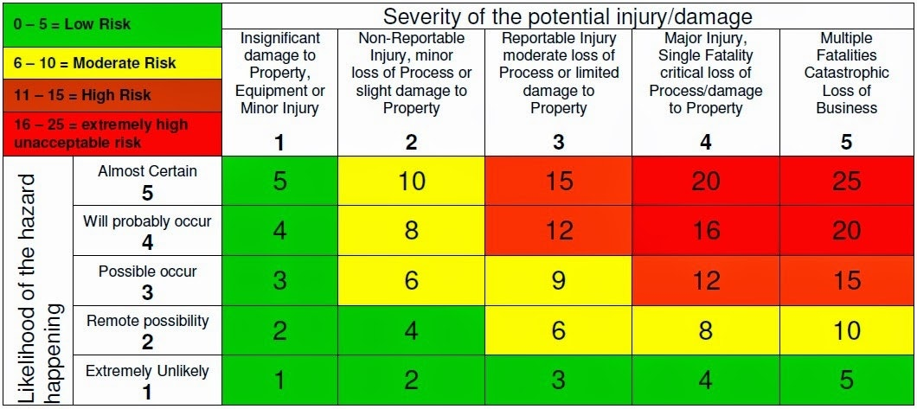
Risk Assessment Matrix

Slide 30
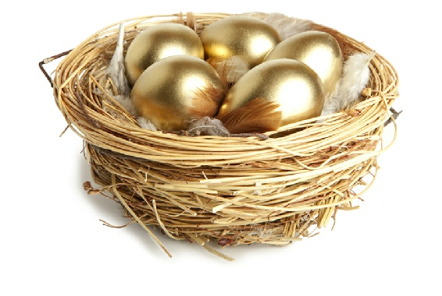
And once you have that golden proposal…
Use it
Recycle it
Adapt it
… and don’t put all your eggs in one basket!

Slide 31
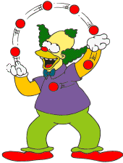
You have to master the art of juggling
… and keeping all the balls in the air at the same time!
Keep your project in scope
Show off your expertise
Explain the problem
you will resolve

Slide 32
Some useful reading matter…
How to get a grant funded David Goldblatt
BMJ VOLUME 317 12 DECEMBER 1998 link
The Art of Grantsmanship, Jacob Kraicer link
Murder Most Foul: How Not to Kill a Grant Application
Vid Mohan-Ram, January 07, 2000 link
University of Michigan Proposal Writer's Guide link

Slide 33
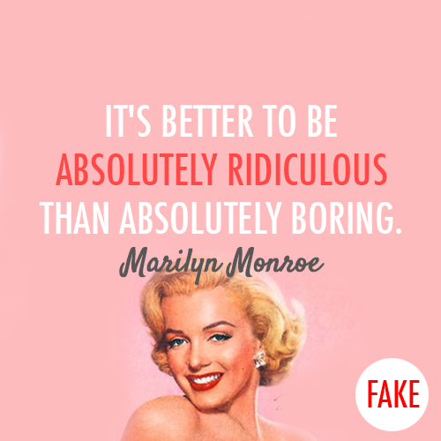
A last word of advice from Marilyn

Slide 34
Thank you for your attention!
Where can you find me?
Ash building, first floor,
grant admin office.
x1465

